Slide 1
Grocery and Gourmet Food Products
PRESENTED BY J PATTY

Slide 2
Model Goal
What food products and categories people are talking about?
Are they talking negatively or positively about these products and categories?
What exactly are they saying?

Slide 3


DATA COLLECTION + PREPROCESSING
WORKFLOW
TOPIC MODELING
DEMONSTRATION
NMF
TF – IDF VECTORIZATION
CountVectorization

Slide 4
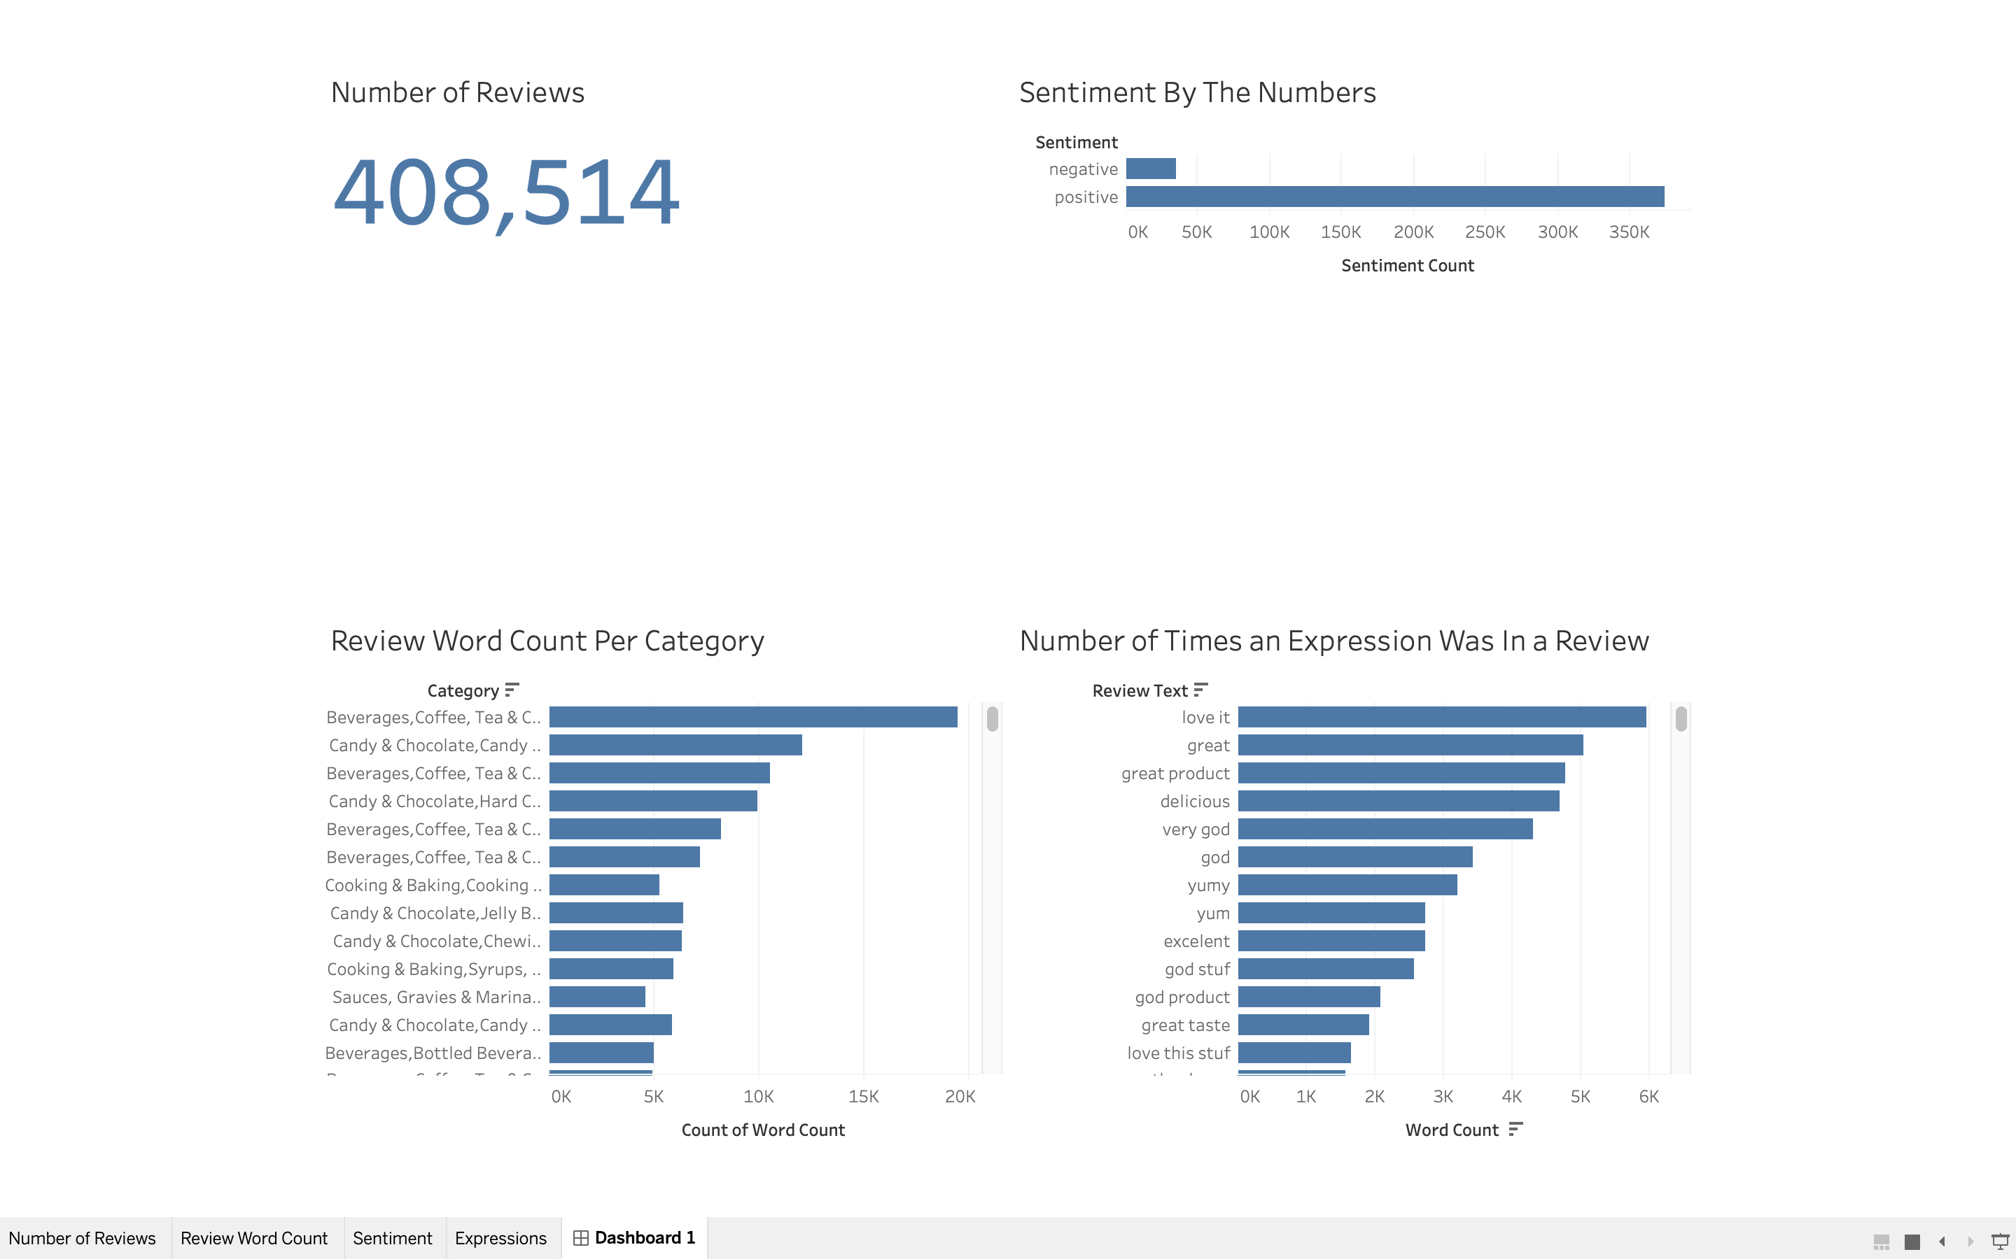
Tableau Dashboard
DEMO

Slide 5
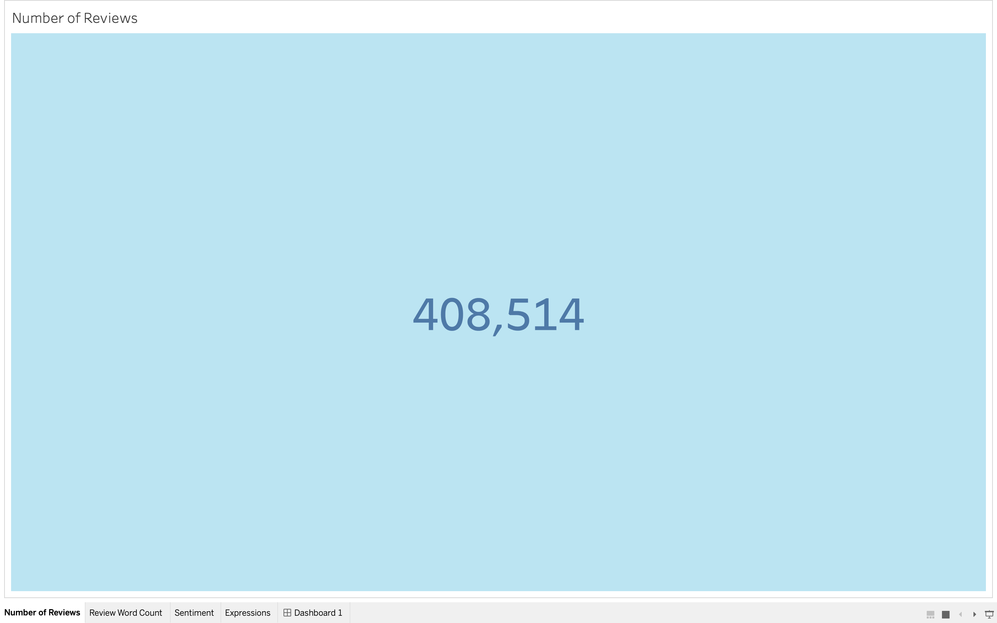
Tableau Number of Amazon Reviews
DEMO

Slide 6
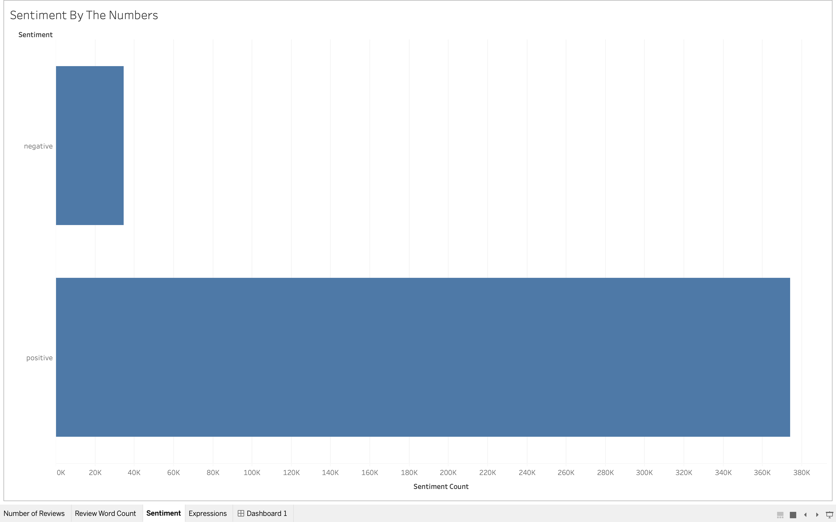
Tableau Sentiment by the Numbers
DEMO
NEGATIVE
POSITIVE

Slide 7
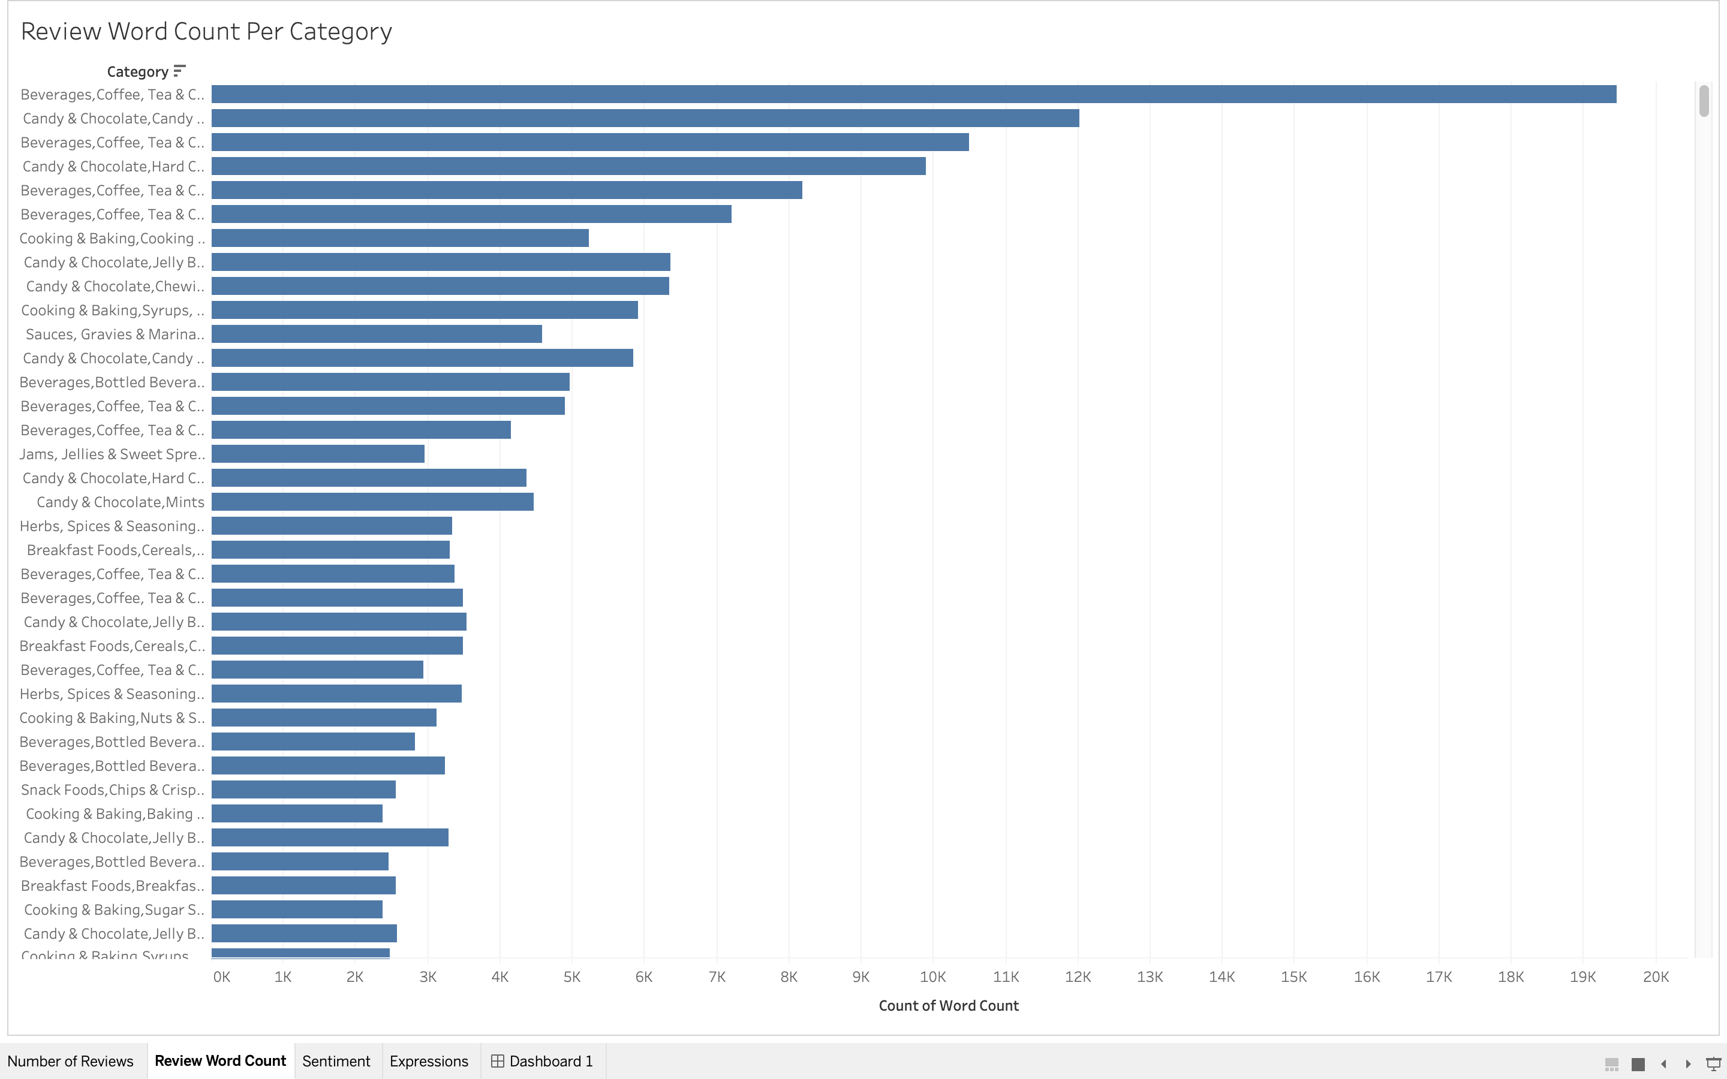
Tableau Wordcount per Category
DEMO

Slide 8
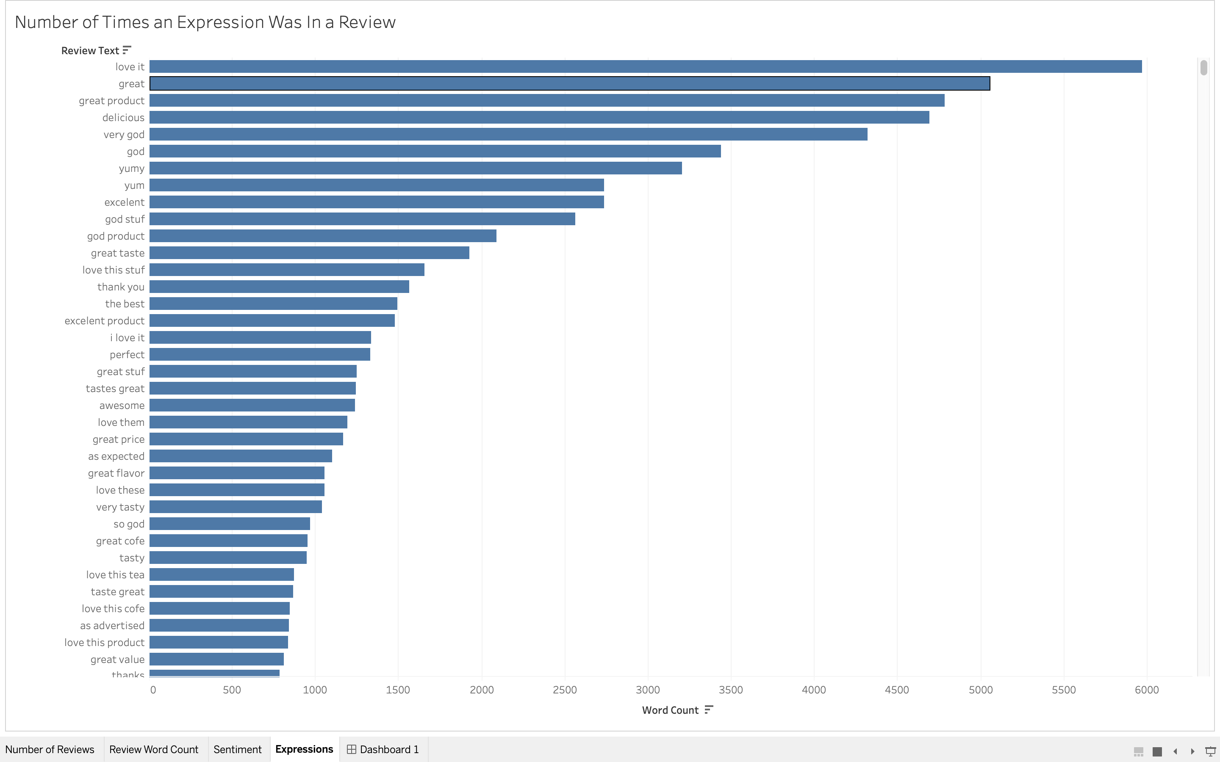
Tableau Number of Times an expression was in a review
DEMO

Slide 9
TOPIC MODELING
TOPIC 1 :
Sweet, Bitter, Sugary, Dark
Tableau Dashboard
“ CHOCOLATE” .
Sweet, Bitter, Rich, Sugary, Dark,
and White
NON-NEGATIVE MATRIX FACTORIZATION

Slide 10
TOPIC MODELING
TOPIC 2 :
Arrived, Service, Fast, Works, and Time
Tableau Dashboard
“ SHIPPING ” .
Arrived, Service, Fast, Works, and Time
NON-NEGATIVE MATRIX FACTORIZATION

Slide 11
TOPIC MODELING
TOPIC 3 :
Amazon, Order, Product, and Stuff
Tableau Dashboard
“STORE ” .
Amazon, Order, Shop and Product
NON-NEGATIVE MATRIX FACTORIZATION

Slide 12
TOPIC MODELING
TOPIC 4 :
Leaves, Sugar, Black , Steep, and Samples
Tableau Dashboard
“ TEA ” .
Leaves, Black , Steep, and Aromatic
NON-NEGATIVE MATRIX FACTORIZATION

Slide 13
TOPIC MODELING
TOPIC 5 :
Cup, Keurig, and Morning
Tableau Dashboard
“ COFFEE ” .
Cup, Keurig, and Morning
NON-NEGATIVE MATRIX FACTORIZATION
Adj → Smooth, Bold, Strong, Roast, and Decaf

Slide 14
FURTHERMORE…
Expand analysis to all 5 million Amazon Grocery and Gourmet reviews
Explore LSA to see how adding negative values impacts the topic ranks
Add GloVe embedding to further explore context and predicting sentiment of product reviews

Slide 15
Thank You!

